Slide 1

Amp Lab PCB Project Proposal
Evan Shelton

Slide 2
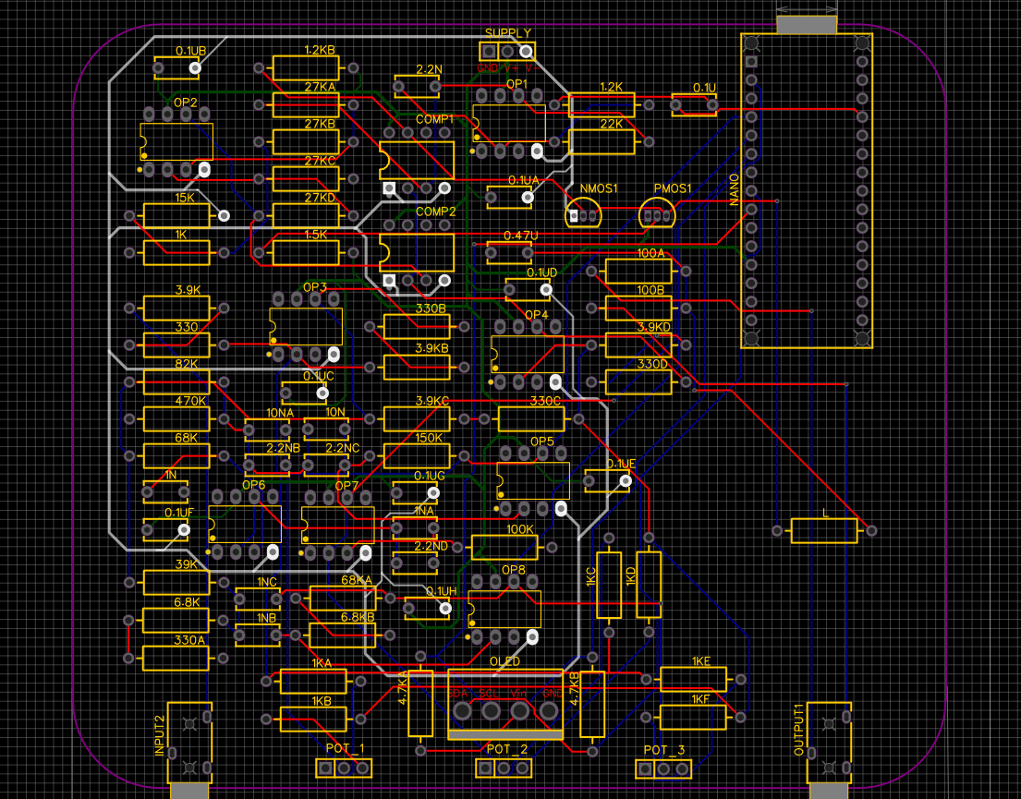
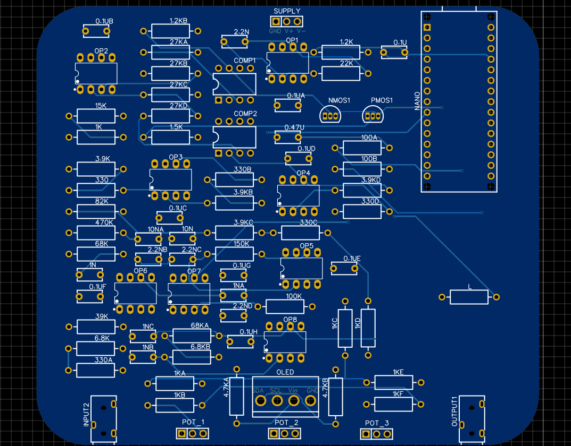
Overview
The goal of this project is to transition an IDP home audio project from multiple bread boards to a clean, compact PCB.
The PCB has already been designed as well as the circuit of the audio system. The goal is to transfer the circuit to the PCB for permanence and size efficiency.

Slide 3
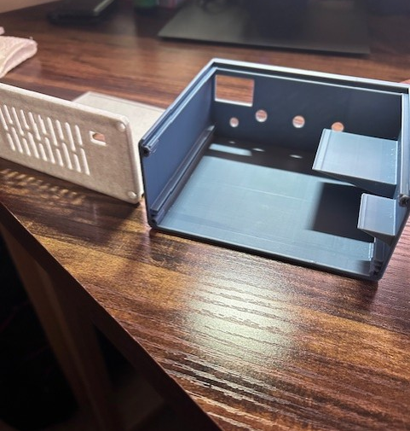
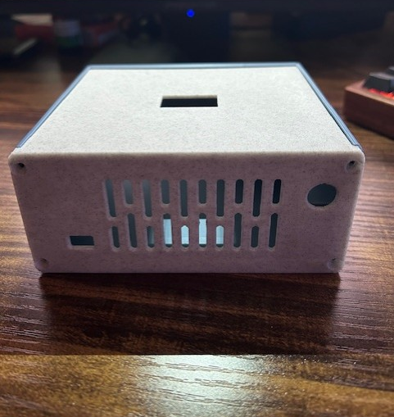
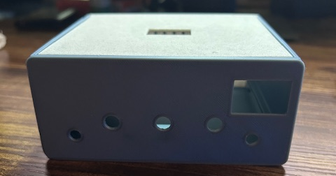
Overview
Along side the PCB, I have also designed and printed a 3d-printed enclosure for the audio system what will house the PCB, have ports for audio jacks and Arduino, allow for the potentiometers to be mounted, and view the OLED display.

Slide 4
Educational Value
This project has and will challenge me further in aspects of PCB designing and soldering. While I have experience with both, this will be the most complex design and largest soldering task I have ever worked on. These are both useful skills to have in EE and this is a project I am passionate about and would like to use to further my skills while creating a more permanent representation of my IDP project.

Slide 5
Component Cost
The cost for the PCB according to JLCPCB will be
Manufacturing: $30.80
Shipping: $29.51
Total: $60.31
All the physical components used for the project are included in my lab kit from ECE 1004
There are a couple other components needed but I either own them already or have already purchased them: ie. Arduino Nano, 10k potentiometers that can be thread mounted, female audio jacks, and a 12V DC power supply.

Slide 6
Timeline
The PCB manufacturing and shipping could take some time potentially upwards of two weeks.
Ideally the board could be shipped and arrive on campus by the end of the semester.
Once the board does arrive, I am confident the soldering and assembly would be done within the week the board arrives.

